Slide 1

Airline Passenger Satisfaction
Luluh Al Quraishi

Slide 2
Agenda
Abstract
Data Description
EDA
Re-Processing
Model Evaluation

Slide 3

Abstract
Airlines strive to satisfy the passengers in all respects .
Through Technology and Advanced science, Airline companies can predict the satisfaction of the traveler.

Slide 4


Data Description
Around 130,000 survey entries.
23 feature columns and the passengers rate the flight experience on a scale of 1 to 5.
Target -> Satisfied

Slide 5
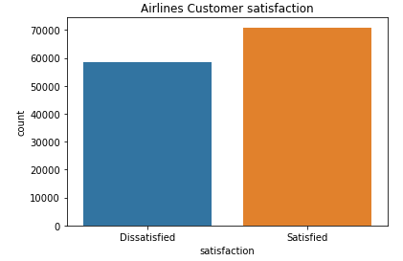
Exploratory Data Analysis (EDA)
Balanced Dataset

Slide 6
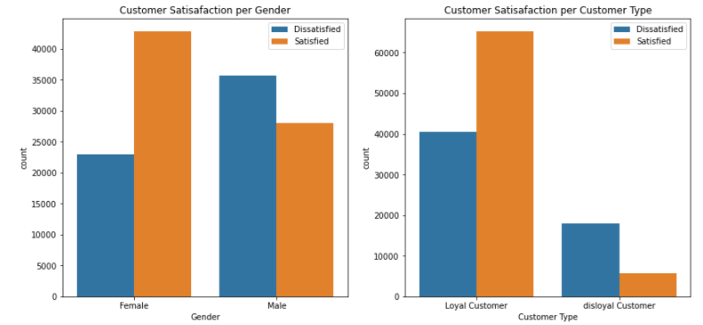
Exploratory Data Analysis (EDA)

Slide 7
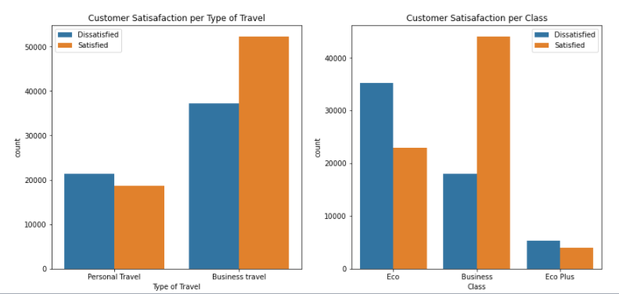
Exploratory Data Analysis (EDA)

Slide 8
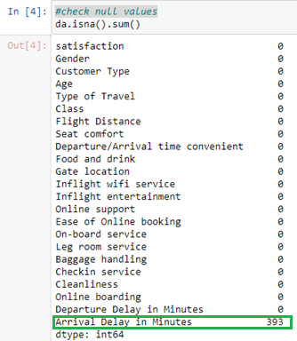
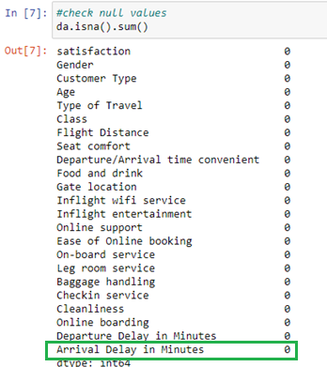
Re-Processing
Cleansing
There is a NULL value in of the columns .

Slide 9
Re-Processing
Split :
The data has been split to Train data & Test Data

Slide 10

Model Evaluation
Logistic Regression

Slide 11
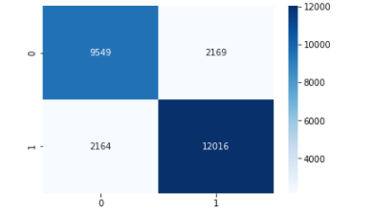
Model Evaluation
2) Confusion Matrix

Slide 12
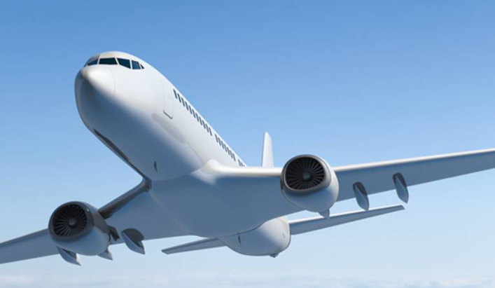
Thank You ..

